Slide 1
Review for Final Exam
Some important themes from Chapters 9-11
Final exam covers these chapters, but implicitly tests the entire course, because we use sampling distributions, confidence intervals, significance tests, etc.
As usual, exam is mixture of true/false to test concepts and problems (like examples in class and homework), with emphasis on interpreting software output.

Slide 2

Chap. 9: Linear Regression and Correlation
Data: y – a quantitative response variable
x – a quantitative explanatory variable
We consider:
Is there an association? (test of independence using slope)
How strong is the association? (uses correlation r and r²)
How can we predict y using x? (estimate a regression equation)
  Linear regression equation E(y) = α + β x describes how mean of conditional distribution of y changes as x changes
  Least squares estimates this and provides a sample prediction equation

Slide 3
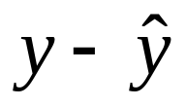

The linear regression equation E(y) =  +  x is part of a model. The model has another parameter σ that describes the variability of the conditional distributions; that is, the variability of y values for all subjects having the same x-value.
For an observation, difference between observed value of y and predicted value of y,
is a residual (vertical distance on scatterplot)
Least squares method minimizes the sum of squared residuals (errors), which is SSE used also in r² and the estimate s of conditional standard deviation of y

Slide 4
Measuring association:
The correlation and its square
  The correlation is a standardized slope that does not depend on units
  Correlation r relates to slope b of prediction equation by
r = b(s_{x}/s_{y})
-1 ≤ r ≤ +1, with r having same sign as b and r = 1 or -1 when all sample points fall exactly on prediction line, so r describes strength of linear association
The larger the absolute value, the stronger the association
Correlation implies that predictions regress toward the mean

Slide 5
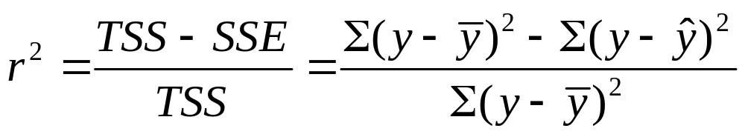
The proportional reduction in error in using x to predict y (via the prediction equation) instead of using sample mean of y to predict y is
Since -1 ≤ r ≤ +1, 0 ≤ r² ≤ 1, and r² = 1 when all sample points fall exactly on prediction line
r and r² do not depend on units, or distinction between x, y
The r and r² values tend to weaken when we observe x only over a restricted range, and they can also be highly influenced by outliers.

Slide 6
Inference for regression model
Parameter: Population slope in regression model (β)
H₀: independence is H₀:  = 0
Test statistic t = (b – 0)/se, with df = n – 2
A CI for  has form b ± t(se)
where t-score has df = n-2 and is from t-table with half the error probability in each tail. (Same se as in test)
In practice, CI for multiple of slope (e.g., 10) may be more relevant (find by multiplying endpoints of CI for  by the relevant constant)
CI not containing 0 is equivalent to rejecting H₀ (when error probability is same for each)

Slide 7
Software reports SS values (SSE, regression SS, TSS = regression SS + SSE) and F test results in an ANOVA (analysis of variance) table
The F statistic in the ANOVA table is the square of the t statistic for testing H₀:  = 0. It has the same P-value as for the two-sided test.
We need to use F when we have several parameters in H₀ , such as in testing that all  parameters in a multiple regression model = 0 (see Chapter 11)

Slide 8
Chap. 10: Introduction to Multivariate Relationships
Bivariate analyses informative, but we usually need to take into account many variables.
Many explanatory variables have an influence on any particular response variable.
The effect of an explanatory variable on a response variable may change when we take into account other variables. (Recall admissions into Berkeley example)
When each pair of variables is associated, then a bivariate association for two variables may differ from its “partial” association, controlling for another variable

Slide 9
Association does not imply causation!
With observational data, effect of X on Y may be partly due to association of X and Y with other lurking variables.
Experimental studies have advantage of being able to control potential lurking variables (groups being compared should be roughly “balanced” on them).
When X₁ and X₂ both have effects on Y but are also associated with each other, there is confounding. It’s difficult to determine whether either truly causes Y, because a variable’s effect could be at least partially due to its association with the other variable.

Slide 10
Simpson’s paradox: It is possible for the (bivariate) association between two variables to be positive, yet for the partial association to be negative at each fixed level of a third variable (or reverse)
Spurious association: Y and X₁ both depend on X₂ and association disappears after controlling X₂
Multiple causes more common, in which explanatory variables have associations among themselves as well as with response var. Effect of any one changes depending on what other variables controlled (statistically), often because it has a direct effect and also indirect effects.
Statistical interaction – Effect of X₁ on Y changes as the level of X₂ changes (e.g., non-parallel lines in regr.)

Slide 11
Chap. 11: Multiple Regression
y – response variable
x₁, x₂ , … , x_{k} -- set of explanatory variables
All variables assumed to be quantitative (later chapters incorporate categorical variables in model also)
Multiple regression equation (population):
E(y) = α + β₁x₁ + β₂x₂ + …. + β_{k}x_{k}
Controlling for other predictors in model, there is a linear relationship between E(y) and x₁ with slope β_{1.}

Slide 12
Partial effects in multiple regression refer to statistically controlling other variables in model, so differ from effects in bivariate models, which ignore all other variables.
Partial effect of a predictor in multiple regression is identical at all fixed values of other predictors in model (assumption of “no interaction,” corresponding to parallel lines)
Again, this is a model. We fit it using least squares, minimizing SSE out of all equations of the assumed form. The model may not be appropriate (e.g., if there is severe interaction).
Graphics include scatterplot matrix (corresponding to correlation matrix), partial regression plots to study effect of a predictor after controlling (instead of ignoring) other var’s.

Slide 13
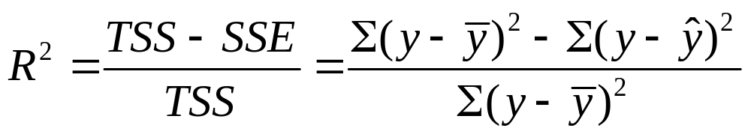
Multiple correlation and R²
The multiple correlation R is the correlation between the observed y-values and predicted y-values.
R² is the proportional reduction in error from using the prediction equation (instead of sample mean) to predict y
0 ≤ R² ≤ 1 and 0 ≤ R ≤ 1.
R² cannot decrease (and SSE cannot increase) when predictors are added to a regression model
The numerator of R² (namely, TSS – SSE) is the regression sum of squares, the variability in y “explained” by the regression model.

Slide 14
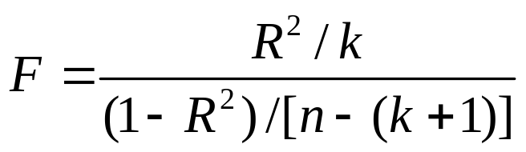
Inference for multiple regression model
To test whether k explanatory variables collectively have effect on y, we test
H₀ : ₁ = ₂ = … = _{k} = 0
Test statistic
When H₀ true, F values follow the F distribution
df₁ = k (no. of predictors in model)
df₂ = n – (k+1) (sample size – no. model
parameters)

Slide 15
Inferences for individual regression coefficients
To test partial effect of x_{i} controlling for the other explan. var’s in model, test H₀: _{i} = 0 using test stat.
t = (b_{i} – 0)/se, df = n - (k + 1)
CI for _{i} has form b_{i} ± t(se), with t-score also having
df = n - (k + 1), for the desired confidence level
Partial t test results can seem logically inconsistent with result of F test, when explanatory variables are highly correlated

Slide 16
Modeling interaction
The multiple regression model
E(y) = α + β₁x₁ + β₂x₂ + …. + β_{k}x_{k}
assumes the partial slope relating y to each x_{i} is the same at all values of other predictors
Model allowing interaction (e.g., for 2 predictors),
E(y) = α + β₁x₁ + β₂x₂ + β₃(x₁x₂)
= (α + β₂x₂) + (β₁ + β₃x₂)x₁
is special case of multiple regression model
E(y) = α + β₁x₁ + β₂x₂ + β₃x₃
with x₃ = x₁x₂

Slide 17
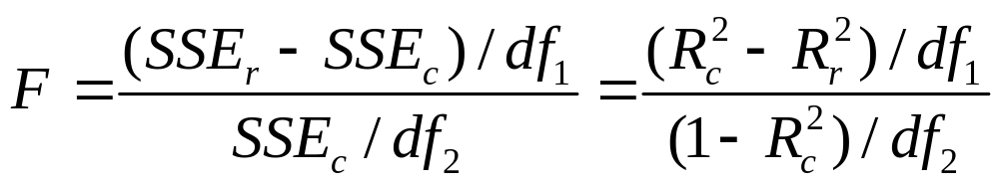
Comparing two regression models
To test whether a model gives a better fit than a simpler model containing only a subset of the predictors, use test statistic
df₁ = number of extra parameters in complete model,
df₂ = n-(k+1) = df₂ for F test that all β’s in complete model = 0
Application: Compare model with many interaction terms to simpler model without them

Slide 18
How do we include categorical explanatory variable in model (Ch. 12)?
Preview in Exercises 11.66 and 11.67
y = selling price of home (thousands of dollars)
x₁ = size of home (in square feet)
x₂ = whether the home is new (1 = yes, 0 = no)
x₂ is a “dummy variable” (also called “indicator variable”)
Predicted y-value = -26 + 73x₁ + 20x₂
The difference in predicted selling prices for new homes and older homes of a fixed size is 20, i.e., $20,000.

Slide 19
How do we include categorical response variable in model (Ch. 15)?
Model the probability for a category of the response variable
Need a mathematical formula more complex than a straight line, to keep predicted probabilities between 0 and 1
Logistic regression uses an S-shaped curve that goes from 0 up to 1 or from 1 down to 0 as a predictor x changes

